Slide 1
MUSIC GENRE IDENTIFICATION
Saicharan Amaravathi
Thrivenubabu Manukonda

Slide 2
INTRODUCTION
The term "neural network" refers to a collection of algorithms that attempt to emulate the human brain by determining the link between pieces of data. It's employed in a variety of applications, including regression, classification, and image recognition, among others.
The biological neural network processes data in parallel, but the artificial neural network processes data in series. Additionally, the former's processing is slower (in milliseconds), whilst the latter's processing is quicker (in a nanosecond).
A neural network includes several layers, each of which performs a specialized job. As the model's complexity grows, the number of layers grows as well, which is why it's called a multi-layer perceptron.

Slide 3
OBJECTIVES:
Humans are very skilled at determining the genre a music belongs to.
We can determine whether we're listening to classical music, rap, or mass in a matter of seconds.
We want to create a machine learning system that automatically categorizes songs based on their genre.

Slide 4
APPROACH:
According to studies, while a person is listening to music, the brain's attention is drawn to transitions, which often coincides with the loudest sections of the song.
This suggests that the loudest portion of the song may include vital information about the dataset's genre.
As a result, we decided to integrate the Mel-Frequency, Cepstral Coefficients, Spectral Centroid, Zero Crossing Rate, Chroma Frequencies, Spectral Roll-off features, which corresponds to the song's loudest passages.

Slide 5
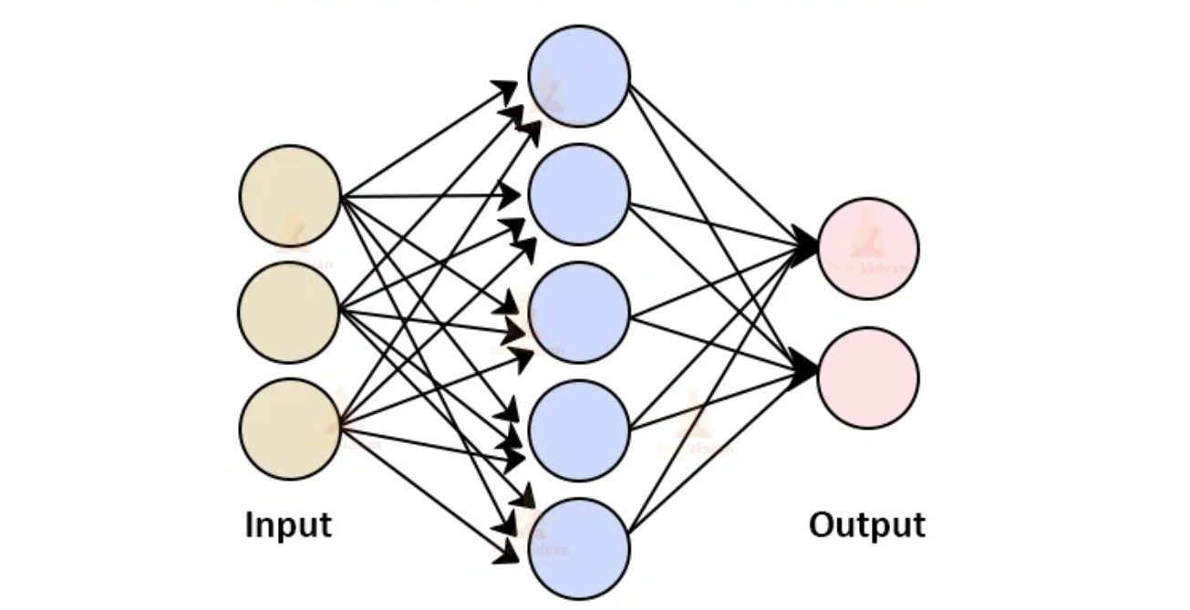
ARCHITECTURE OF ANN

Slide 6
A neural network in its purest form includes three layers:
-an input layer,
-a hidden layer,
-an output layer.
The input layer receives the input signals and passes them on to the next layer, with the output layer delivering the final prediction. These neural networks, like machine learning methods, must be taught with some training data before being used to solve a specific issue.

Slide 7
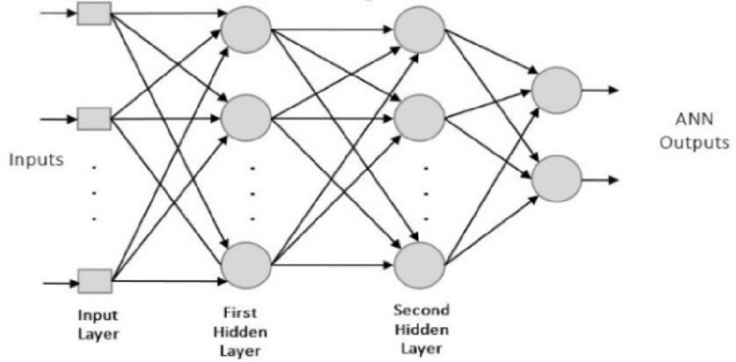
PERCEPTRON
As previously mentioned, in a multi-layered perceptron, these are the concealed or thick layers. They're made up of a lot of neurons, and neurons are the basic building blocks of a perceptron. In simple terms, each node represents a neuron, and a vertical arrangement of neurons represents perceptrons, which is essentially a dense layer, as seen in the below image.

Slide 8
Each neuron has some weights and biases, and calculations are done as follows: combination = bias + weights * input, followed by the activation function output = activation (combination)
Other activation functions include ReLU, Leaky ReLU, tanh, and a slew of others.

Slide 9
WORKING OF ANN
Information is first fed into the input layer, which then passes it on to the hidden layers, and the interconnection between these two layers assigns weights to each input randomly at first.
Forward Propagation is the name given to this entire process.
The Activation Function is in charge of deciding which node to fire for feature extraction after comparing the output model to the original output and determining the error, weights are adjusted in backward propagation to lower the error, and this process is repeated for a set number of epochs (iterations). Finally, the model weights are adjusted, and the prediction process is completed.

Slide 10
ADVANTAGES
Because many interactions between input and output are non-linear, ANN can learn and model non-linear and complicated relationships.
After training, ANN may infer previously unknown associations from previously unknown data, making it generic.
Unlike many other machine learning models, ANN does not impose any limits on datasets, such as requiring data to be distributed in a Gaussian or other distribution.

Slide 11
APPLICATONS
ANN has a wide range of applications.
* Forecasting
* Credit rating.
* Fraud Detection.
.

Slide 12
Let’s implement the code now

Slide 13
Dataset:
We have used the famous GITZAN dataset for our case study. This dataset was used for the well-known paper in genre classification “ Musical genre classification of audio signals “ by G. Tzanetakis and P. Cook in IEEE Transactions on Audio and Speech Processing 2002.
The dataset consists of 1000 audio tracks each 30 seconds long. It contains 10 genres namely, blues, classical, country, disco, hiphop, jazz, reggae, rock, metal and pop. Each genre consists of 100 sound clips.

Slide 14
Evaluation methodology
Accuracy
Accuracy is defined as closeness of the measurements to a specific value.
Mathematically,
Accuracy = Number of correct predictions/Total of all cases to be predicted
Our model produced 63% accuracy on the validation dataset as well as test dataset.

Slide 15
Conclusion:
Thus, Artificial Neural Network (ANN) helped us classify the music into various types of genres such as pop, disco, jazz, metal, hiphop, reggae, rock, blues, classical with an accuracy of 63%.

Slide 16
Thank you

